Slide 1
CSE 231 (Microprocessor and Assembly Language)
Fall 2015
Notes:
‹#›
786
Md. Tarek Habib

Slide 2
Topic Contents
The FLAGS Register
Overflow
How Instructions Affect the Flags

Slide 3
The Processor Status and the FLAGS Register

Slide 4
The FLAGS Register
The flags are placed in the FLAGS register and they arc classified as either status flags or control flags.
The status flags reflect the result of a computation.
They are affected by the machine instructions.
They are used to implement jump instructions that allow programs to have multiple branches and loops.
The control flags are used to enable or disable certain operations of the processor
‹#›

Slide 5
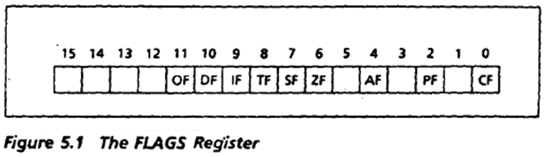
The FLAGS Register
Figure 5.1 shows the FLAGS register.
The status flags are located in bits 0, 2, 4, 6, 7, and 11 and the control flags are located in bits 8, 9, and 10.
The other bits have no significance.
In this topic, we concentrate on the status flags.
‹#›

Slide 6
The FLAGS Register
msb: The most significant bit, or msb, is the leftmost bit in an 8-bit byte or a 16-bit word. In a word, the msb is bit 15; in a byte, it is bit 7.
lsb: The least significant bit, or lsb, is the rightmost bit in an 8-bit byte or a 16-bit word. In a byte or word, the lsb is bit 0.
‹#›

Slide 7
The FLAGS Register
Carry Flag (CF) : CF = 1 if there is a carry out from the most significant bit (msb) on addition, or there Is a borrow into the msb on subtraction; otherwise, it is 0. CF is also affected by shift and rotate Instructions.
Parity Flag (PF) : PF = 1 if the low byte of a result has an even number of one bits (even parity). It is O if the low byte has, odd parity. For example, if the result of a word addition is FFFEh, then the low byte contains 7 one bits, so PF=0.
Auxiliary Carry Flag (AF) : AF = 1 if there is a carry out from bit 3 on addition, or a borrow into bit 3 on subtraction.
‹#›

Slide 8
The FLAGS Register
Sign Flag (SF) : SF = 1 if the msb of a result is 1; it means the result is negative if you are giving a signed interpretation. SF = 0 if the msb is 0 .
Overflow Flag (OF) : OF = 1 if signed overflow occurred, otherwise it is 0.
Zero Flag (ZF) : ZF = 1 for a zero result, and ZF = 0 for a nonzero result.
‹#›
‹#›

Slide 9
Overflow
Signed and unsigned overflows are independent phenomena. When we perform an arithmetic operation such as addition, there are four possible outcomes:
(1) no overflow,
(2) signed overflow only,
(3) unsigned overflow only, and
(4) both signed and unsigned overflows.
‹#›

Slide 10

Unsigned Overflow
As an example of unsigned overflow but not signed overflow, suppose AX contains FFFFh, BX contains 0001 h, and ADD AX,BX is executed. The binary result is-
If we are giving an unsigned interpretation, the correct answer is 1OOOOh = 65536, but this is out of range for a word operation. A 1 is carried out of the msb and the answer stored in AX, OOOOh, is wrong, so unsigned overflow occurred. But the stored answer is correct as a signed number, for FFFFh = -1. OOO1h = 1, and FFFFh + OOO1h = -1 + 1 = 0, so signed overflow did not occur.
‹#›

Slide 11

Signed Overflow
As an example of signed but not unsigned overflow, suppose AX and BX both contain 7FFFh, and we execute ADD AX,BX. The binary result is
The signed and unsigned decimal interpretation of 7FFFh is 32767. Thus for both signed and unsigned addition, 7FFFh + 7FFFh = 32767 + 32767 = 65534.
This is out of range for signed numbers; the signed interpretation of the stored answer FFFEh is 2. so signed overflow occurred. However, the unsigned interpretation of FFFEh is 65534, which is the right answer, so there no unsigned overflow.
‹#›

Slide 12
Unsigned Overflow
On addition, unsigned overflow occurs when there Is a carry out of the msb. This means that the correct answer is larger than the biggest unsigned number; that is, FFFFh for a word and FFh for a byte .
On subtraction, unsigned overflow occurs when there is a borrow into the msb. This means that the correct answer is smaller than 0.
‹#›

Slide 13
Signed Overflow
On addition of numbers with the same sign, signed overflow occurs when the sum has a different sign. This happened in the preceding example when we were adding 7FFFh. and 7FFFh (two positive numbers), but got FFFEh (a negative result).
Subtraction of numbers with different signs is like adding numbers of the same sign. For example, A -(-B) = A + B and -A -(+B) = -A + -B. Signed overflow occurs if the result has a different sign than expected.
‹#›

Slide 14
Signed Overflow
In addition of numbers with different signs, overflow is impossible, because a sum like A + ( -B) is really A - B, and because A and B are small enough to fit in the destination, so is A - B. For exactly the same reason, subtraction of numbers with the' same sign cannot give overflow.
Actually, the processor. uses the following method to set the OF: If the carries into and out of the msb don't match-that is, there is a carry into the msb but no carry out, ·or if there is a carry out but no carry in-then signed overflow has occurred, and OF is set to 1.
‹#›

Slide 15
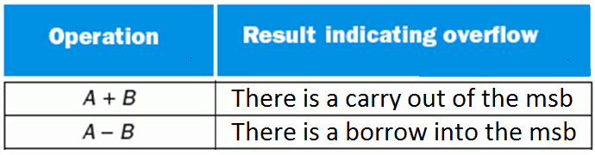
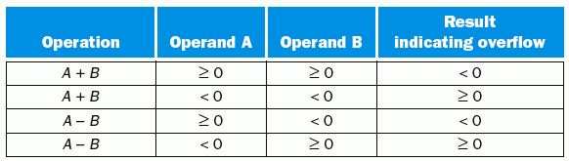
Signed Overflow
Unsigned overflow conditions for addition and subtraction:
Signed overflow conditions for addition and subtraction:
‹#›

Slide 16
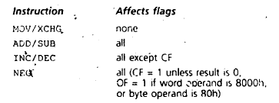
How Instructions Effect the Flags
‹#›

Slide 17
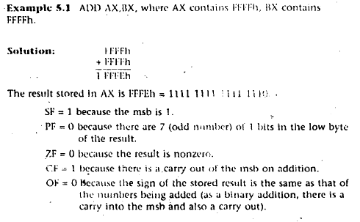
Examples
‹#›

Slide 18
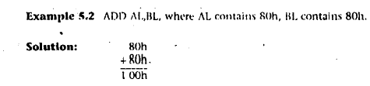
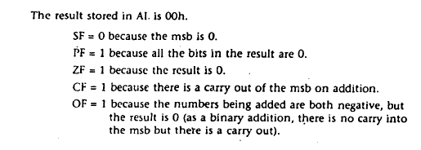
Examples
‹#›

Slide 19
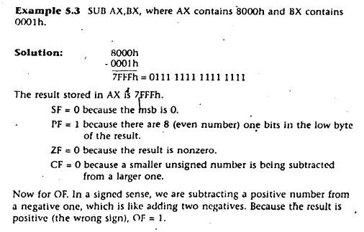
Examples
‹#›

Slide 20
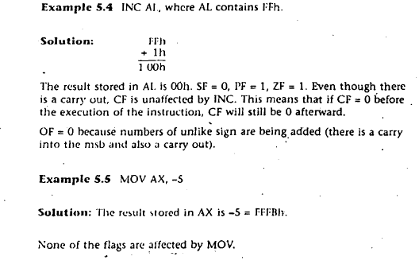
Examples
‹#›

